Slide 1
Model Validation Metrics: Accuracy, Precision, Recall, and F1 Score
S Sharon Karunya

Slide 2
Introduction
Why validation metrics are needed?
Metrics serve as benchmark for evaluating success
Real world applications
Metrics are used across industries for analysis

Slide 3
ACCURACY
• Formula: (TP + TN) / (TP + TN + FP + FN)
• Example:
90 correct predictions out of 100 → Accuracy = 90%
• Limitation: Misleading when classes are imbalanced

Slide 4
PRECISION
• Formula: TP / (TP + FP)
• Meaning:
“Of all predicted positives, how many are correct?”
• Example:
Model predicted 50 positive → 45 correct, 5 wrong → Precision = 90%

Slide 5
RECALL
• Formula: TP / (TP + FN)
• Meaning:
“Of all actual positives, how many did the model catch?”
• Example:
50 actual positives → model caught 45 → Recall = 90%

Slide 6
F1 SCORE
• Formula:
2 × (Precision × Recall) / (Precision + Recall)
• Balances Precision & Recall
• Example: Precision = 0.9, Recall = 0.9 → F1 = 0.9

Slide 7
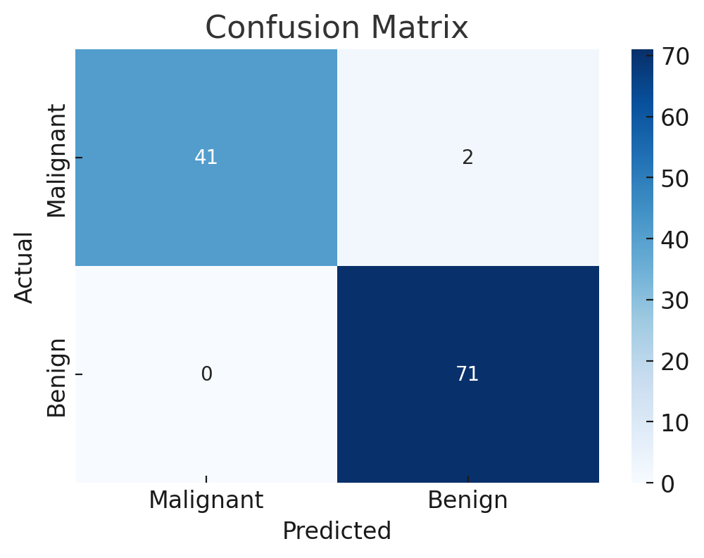
CONFUSION MATRIX
TP, FP, TN, FN
Ex for breast cancer data

Slide 8
Case Study Example
• Disease detection (better recall needed)
• Spam detection (better precision needed)

Slide 9
summary
• Accuracy good for balanced data
• Precision when false positives are costly
• Recall when false negatives are costly
• F1 Score when balance is needed

Slide 10
Thank you

